Slide 1
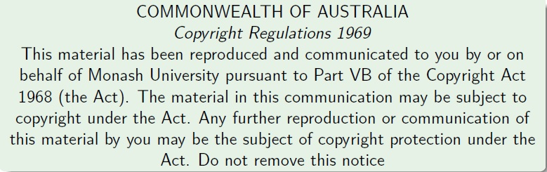
Faculty of Information Technology, Monash University

Slide 2
Announcements/Things to note
Consultation this Friday (2-3 pm)
Shams will replace me as I will be out of city
Location will be confirmed in a Moodle post

Slide 3
Overview
Kahoot Grand Finale
Design Principles (FIT2004 Summary)
Programming Competition Winners
Final Exam etc.

Slide 4
Design Principles (Summing up FIT2004)
Here are some broad strategies to (try to) solve algorithmic problems:
Look out for good invariants to exploit
Attempt to balance your work as much as possible
Do not repeat work (so, store and re-use!)
Use appropriate data structures
Try well-known problem solving strategies
Sometimes greed is good!
These are general guidelines. As always, there are many exceptions

Slide 5
Look out for good invariants to exploit
Here are some algorithms we considered in the unit that do precisely this!
Binary Search (Refer Week 2 lecture)
Sorting (Refer Lectures from Weeks 2 and 3)
Shortest Paths and Connectivity
Dijkstra’s algorithm (Refer Week 8 Lectures)
Floyd-Warshall algorithm (Refer Week 9 lectures)
Minimum Spanning Tree Algorithms (Refer Week 10 lectures)

Slide 6
Balance your work as much as possible
For problems that allow division of labour (eg. Divide and Conquer)
Try to divide work equally as much as possible
Merge sort achieves this
O(N log N)-time always!
Quick sort does not necessarily achieve this – depends on the choice of the pivot (Refer week 3)
Good pivots give O(N log N)-time
Bad pivots give O(N²)-time

Slide 7
Choose Data Structures with care
Certain data representations are more efficient than others for a given problem
Priority Queue in Dijkstra’s algorithm (Refer Week 8)
Union-Find data structure in Kruskal’s algorithm (refer Week 9)
Efficient Search and retrieval data structures of various kinds (Refer Weeks 5,6,7 lectures)

Slide 8
Don’t repeat work
Do not compute anything more than once (if there is room to store it for reuse)
Underpins Dynamic Programming strategy
Edit Distance (Refer Week 4 Lecture)
Knapsack Problem (Refer Week 4 Lecture)

Slide 9
Try well known problem solving strategies
Divide and Conquer (Refer Weeks 3, 4 lectures)
Dynamic Programming (Refer Weeks 4, 8, 9 lectures)

Slide 10
Sometimes greed is good
A greedy strategy is to make a “local” choice based on current information
Sometimes gives optimal solution, e.g.
Dijkstra’s single source shortest paths algorithm (Refer Week 8 Lectures)
Minimim Spanning Tree Algorithms – Prim’s and Kruskal’s (Refer Week 10 lectures) minimum spanning tree algorithm.
Greedy is sometimes a good heuristic!
Sometimes gives a “good” solution to a (combinatorial) problem even if not guaranteed optimal

Slide 11
Overview
Kahoot Grand Finale
Design Principles (FIT2004 Summary)
Programming Competition Winners
Final Exam etc.

Slide 12
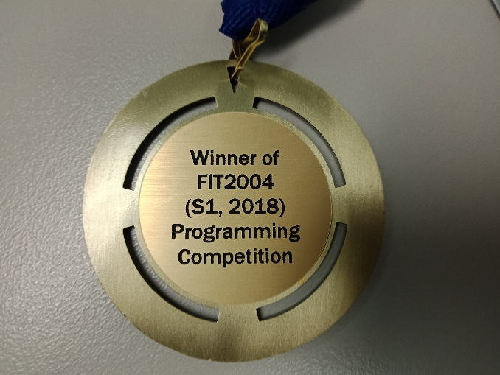
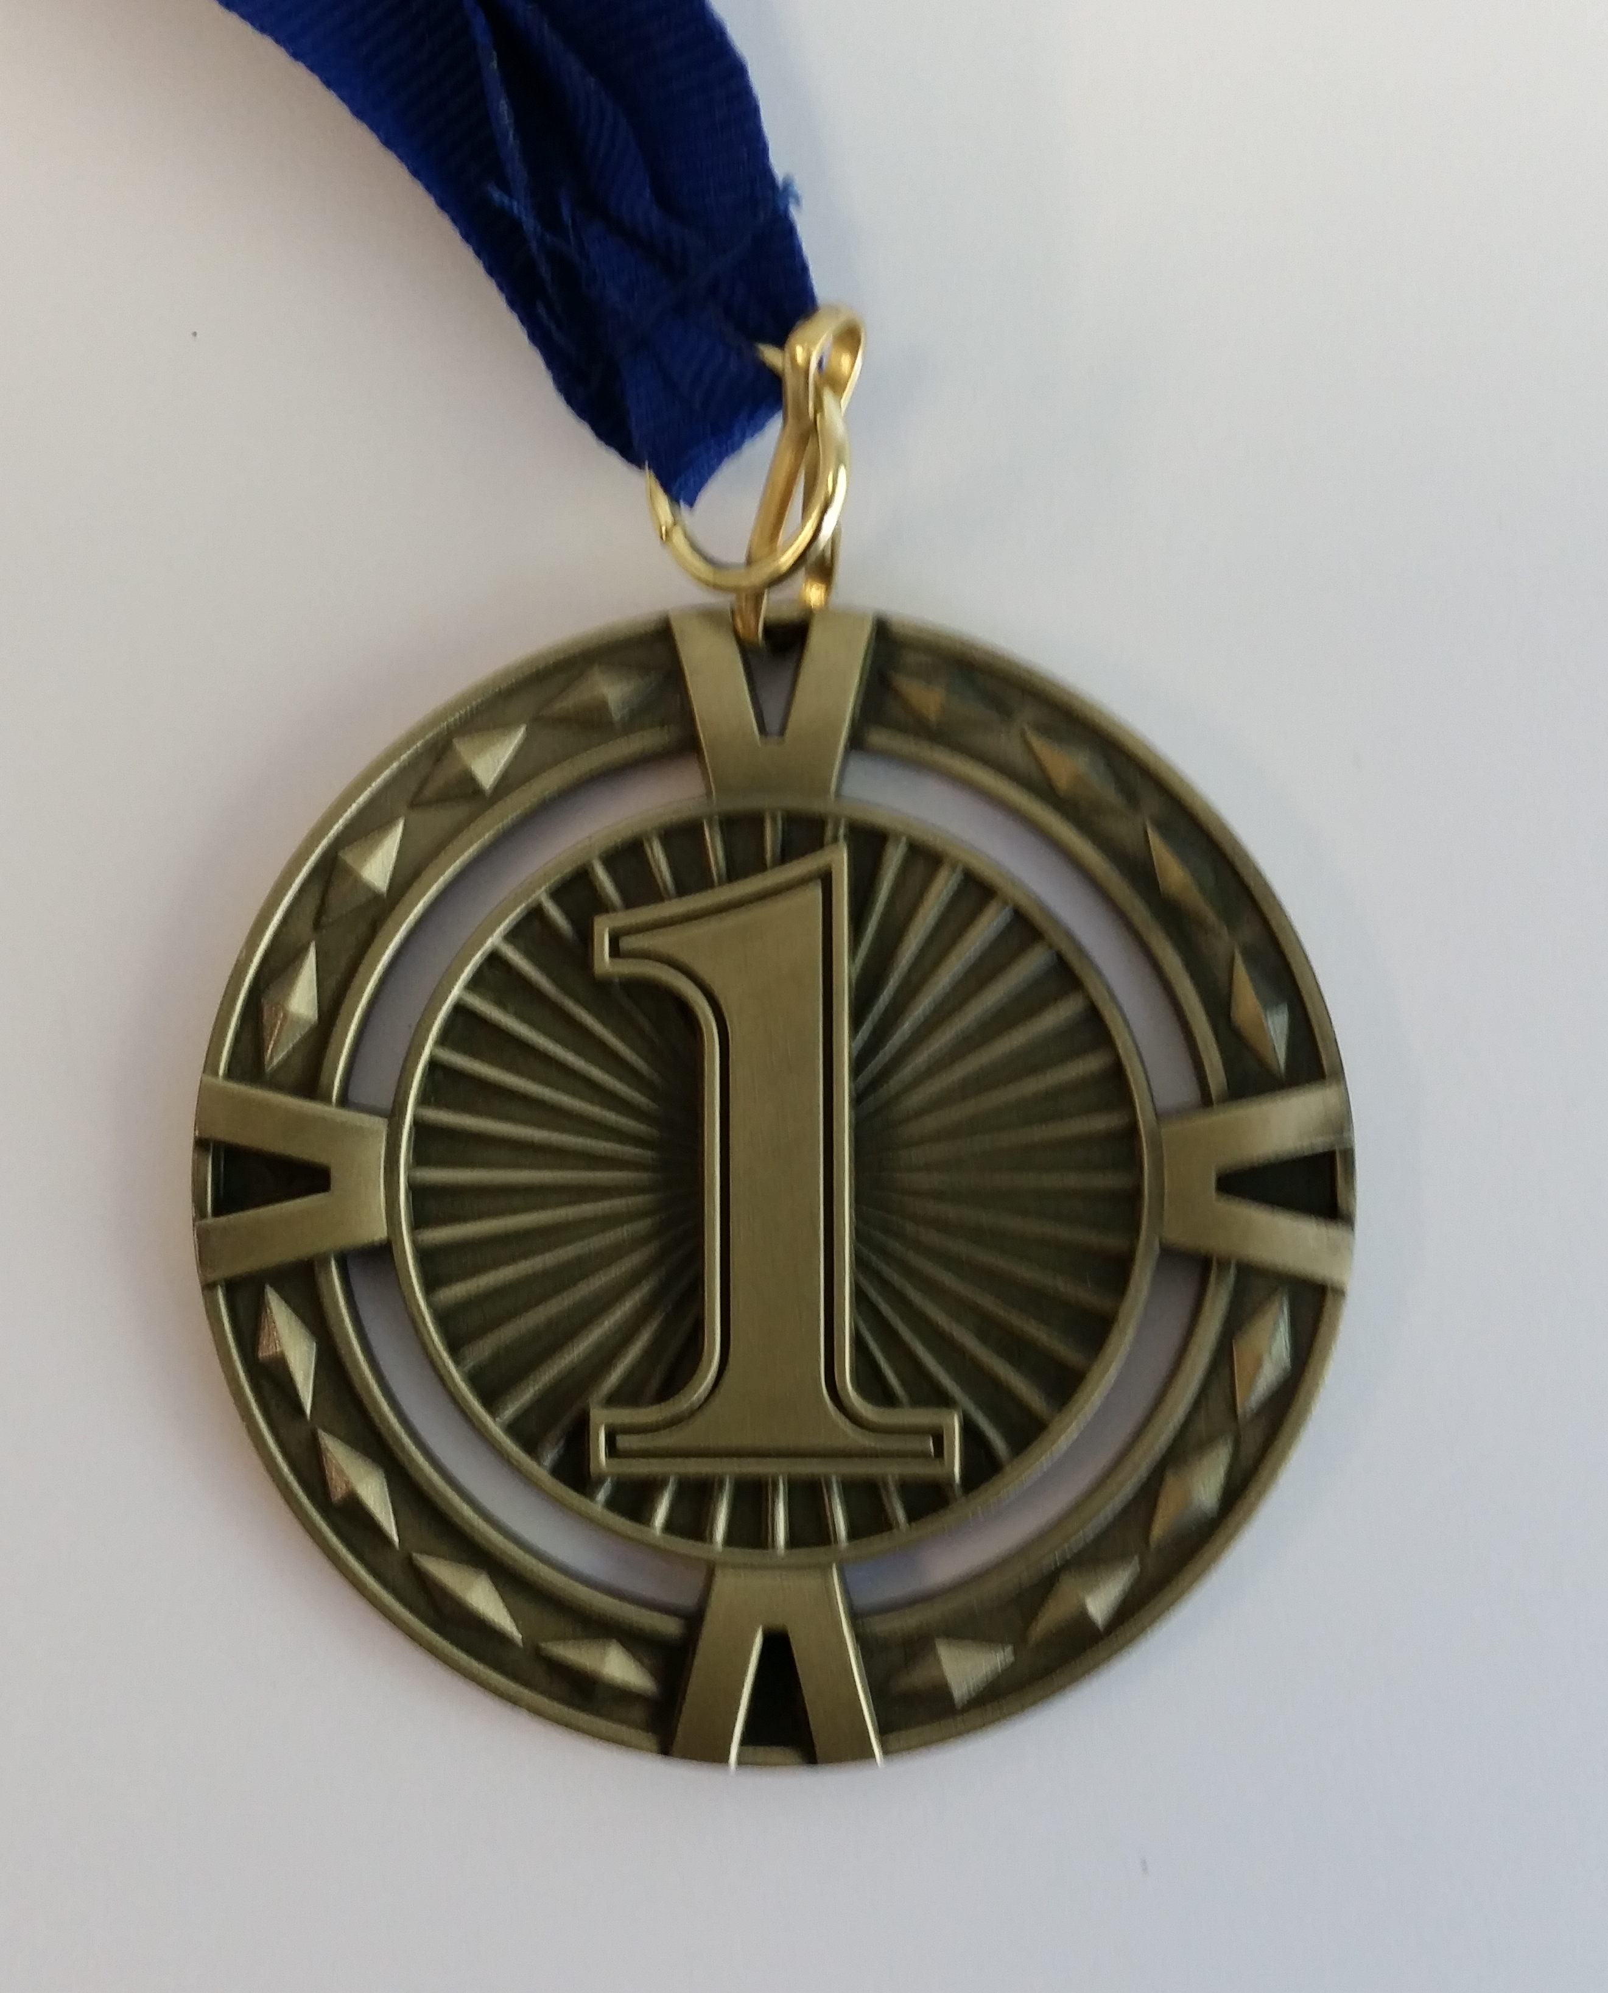
Programming Competition Winners
5th: Tzu-Hsiang Hsu (solved 8, penalty 20)
4th: Wen Gao (solved 9, penalty 19)
3rd: Candice Rimba (solved 9, penalty 9)
2nd: Viet Loc Pham (solved 11, penalty 72)
Champion: Andrew Gammon (solved 12, penalty 10)

Slide 13
Overview
Kahoot Grand Finale
Design Principles (FIT2004 Summary)
Programming Competition Winners
Final Exam etc.

Slide 14
Final Exam
Time allowed: 2 hours + 10 minutes reading time
Total Marks: 60
Exam is NOT open book
Question style similar to mid-semester tests – but do not try to guess what will be on the exam
Hurdles:
At least 16 out of 40 marks in in-semester assessments (assignment + mid-semester test + lecture/tutorial participation)
At least 24 out of 60 marks in the final exam
At least 50 marks overall
Do not miss final exam even if you fail in-semester hurdle.
It affects your WAM

Slide 15
Non-Examinable Content
Additional material in supplementary notes is NOT examinable
In other words, anything NOT covered in lectures, tutorials, labs is NOT EXAMINABLE!

Slide 16
Consultations for Final Exam
Consultation sessions will be organized – please come prepared!
Don’t try getting hints about the questions on final exam!
Important: Last night I got an accident and have lost my memory – so do not waste your energy
Very Important: In many Bollywood movies, a second accident brings the memory back. Please do not pray that I get another accident.
Only I, Ammar (head tutor), Anuja (lecturer at Malaysia campus) and the Chief Examiner have seen the exam paper. Some of the options you have are the following
Selfish Option
Pray that I get another accident
but the second accident may bring false memories and you may get all the wrong hints :P
Risky Option
Ask Ammar. He has told me that he will lie to you :P
Expensive Option
Buy a ticket to Malaysia and try your luck by talking to Anuja :P
Useless Option
Ask the Chief Examiner
I am the Chief Examiner :P
Easiest Option
Study!!!

Slide 17
Suggestions for preparation (written after I lost my memory)
Understand how each algorithm works
Practice writing pseudocode for each algorithm
Understand its complexity analysis
Don’t confuse algorithms: Bellman-Ford vs Floyd-Warshall vs Ford-Fulkerson
Solve different recurrence relations
Prove by induction for recurrence solutions
Practice writing proofs of correctness of algorithms

Slide 18
Algorithm for exam preparation
for i=1 to 12:
carefully go through lecture slides/supplementary notes week i and ensure you understand the content
practice writing pseudocode for each algorithm covered in week i
make sure your understand space/time complexities
if something is unclear:
listen MULO recording # slides are optimized for lectures and should only be treated as summaries.
seek help
for i in range(3,12,2):
attempt tutorial questions week i
for each question attempted:
compare your solution with the sample solution
seek help if something is unclear
for each question on the sample exam and mid-semester tests:
attempt the question
post your solution on Moodle forum
If current_date <= exam_date
goto line 1
Print(“HURRAYYYYYY!!! I did it!”)
# WARNING: This is a brute force algorithm. Using greedy algorithm (studying selected topics) may be disastrous

Slide 19
Summary
Take Home Message
See Design Principles in this lecture
Things to do (this list is not exhaustive)
See the algorithm to prepare for final exam
Coming Up Next

Slide 20

Coming Up Next
SWOT VAC

Slide 21

Coming Up Next
Final Exam

Slide 22
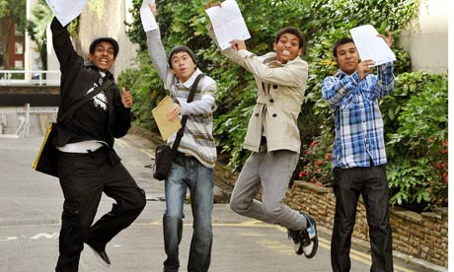
Coming Up Next
Results Day
And you live happily ever after

Slide 23
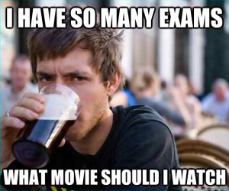
Coming Up Next (Second Scenario)
SWOT VAC

Slide 24
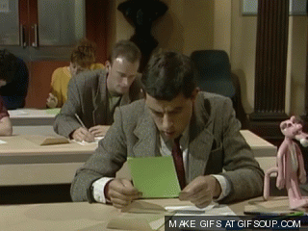
Coming Up Next (Second Scenario)
Final Exam

Slide 25


Coming Up Next (Second Scenario)
Results Day
Moral: Work hard or be brave!

Slide 26


Just before I sign off …
Most of you have done really well given the challenging nature of the unit!
Good luck for the final exam!
Do not hesitate to contact me if I can be of any help even after this semester
E.g., if you need a reference letter

Slide 27

That’s all folks!

